Slide 1
Domino Laser Encoder Calibration
Quickstep 2

Slide 2

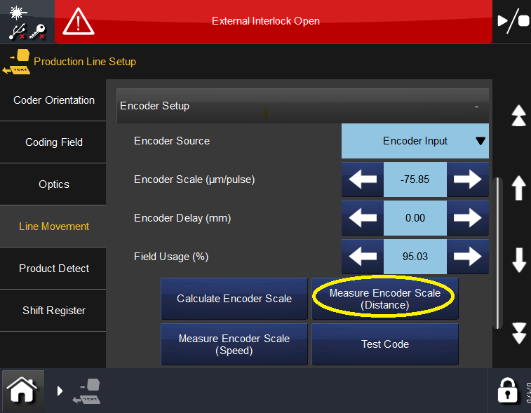
Encoder Scale Calibration – Distance Method
Navigate to Home > Production Line Setup > Line Movement > Encoder Setup > Measure Encoder Scale (Distance)
Stop conveyor line
Place two pieces of tape on the upstream end of the conveyor that moves the product past the laser.
  Place tape piece one on the belt itself
  Piece tape piece two next to it on the stationary part of the conveyor rail.
  *We will be measuring the distance between these pieces so place tape to make this easy to do after the conveyor tape is several feet down the line.

Slide 3
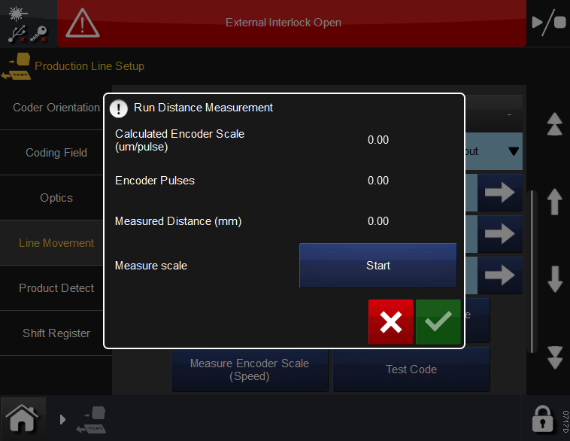
With line stopped and tape in place, Press “Start” button on Laser Touchpanel
Move Conveyor a several feet (the further the better)
Stop Conveyor
Press “Stop” button on Laser Touchpanel
You will notice the Encoder Pulses increased as the line moved
  If this number is less than 25,000 repeat process and move belt a farther distance

Slide 4
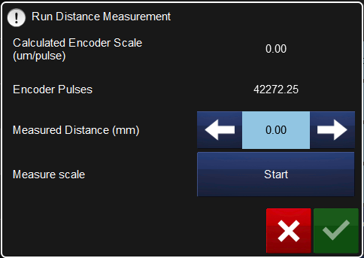
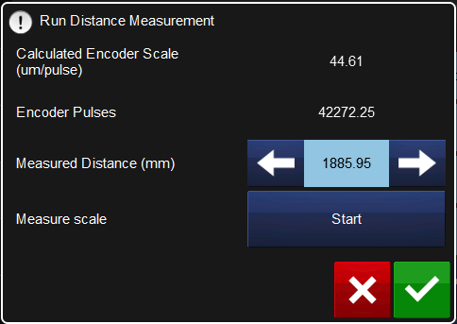
Convert measure distance to millimeters (25.4mm per inch)
*Example 6’ 2 ¼” is 74.25” 74.25 x 25.4 =1,885.95mm
Enter millimeters into the “Measured Distance (mm) block
Press Green Check box
Take note of Encoder Scale, number may be negative depending on encoder installation/rotation on your line

Slide 5
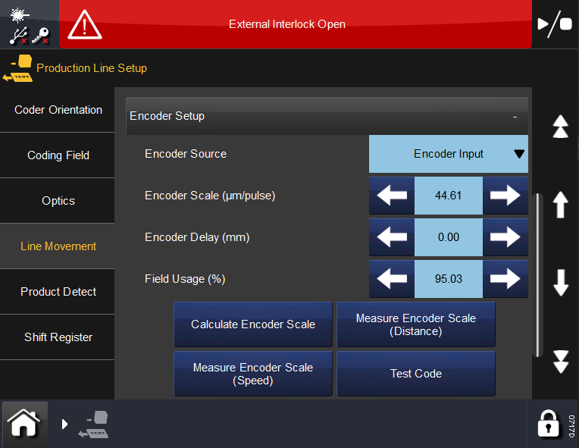
Test line function
Three ways to adjust code location on the product:
  Enter an “Encoder Delay” used to account for distance between Product Detect sensor and Laser Mark Field
  Move code location in the message editor
  Move Product detect sensor up/down stream on the conveyor

